Slide 1
Project Presentation
OR 7310
Logistics, Warehousing and Scheduling
Fall 2020
Group Members:
Karan Parikh
Sabhariram Adinarayanamurthy
Harsh Ajay Doshi
Brinda Tailor

Slide 2
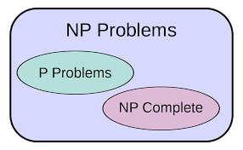
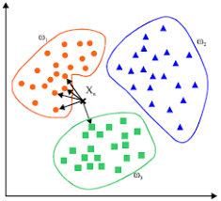
Approach
Tried to solve all the 50 nodes together. Failed miserably
To reduce complexity and find initial basic solution, decided to divide the data points into smaller sets
Divided data in ascending order. Failed again.

Slide 3
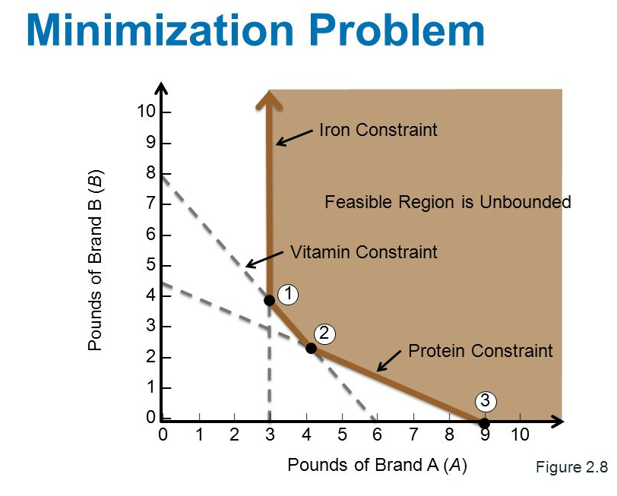
Approach
Initial Feasible Solution
Used Nearest neighbour technique to divide data in sets of 10. (i.e. 5 sets for 50 nodes).
Tried to solve this to get an initial basic feasible solution
Due to the nearest neighbour technique, the last set had nodes which were far apart

Slide 4


Approach
Improvisation
This set basis for improvising the solution we already had on hand
We realized we can use node transfer method to improvise the solution
So, some sets had more nodes than the other, however the results were reduced without increasing computational complexity a lot

Slide 5
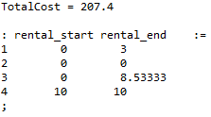

Approach
Lower Bound
Constraint relaxation was used but computational complexity was still high
Then, we did linear relaxation of two integer variables
50 customers: Set 1 Total cost, rental start and end time (14 customers,3 Vans, 1 Truck)

Slide 6
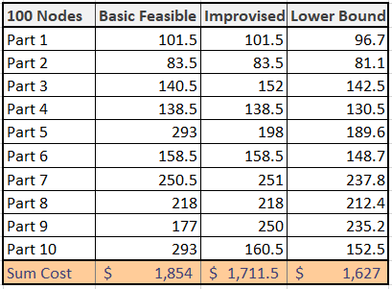


Result
100 customers:

Slide 7
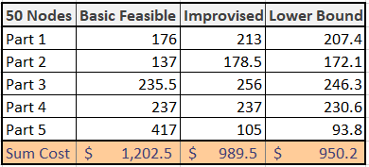

Result
50 customers:

Slide 8

Thank You!!!

